Slide 1
Jack London’s Medicine Case on Display in the House of Happy Walls Museum:
The Drugs He Used in His Life and Literature.
Richard M. Rocco, PhD
Samuel Merritt University
Oakland, CA 94607
August 06, 2026
(Ver 1.9 July 29, 2026)

Slide 2
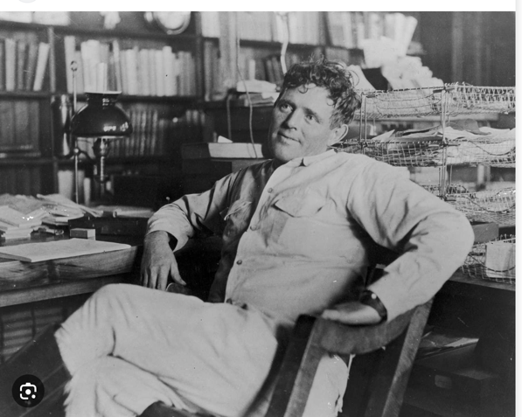
Jack London (1876-1916)
Notes:
First visit to the Museum, a 1909 medicine case is a snapshot of drug therapy a hundred or more years ago. Also, something about Jack London's medical conditions and drug use. Five articles published on Jack London so far thanks to my partner Susan and to the CA Park Service.
Drugs in the medicine case on display here in the Museum that Jack London used in his life and literature will be discussed.
salicylate (Aspirin) for his rheumatism
quinine (for malaria)
opium (for pain and diarrhea)
an antimicrobial for bacterial infections
Heroin (for cough suppression because of his bronchitis)

Slide 3
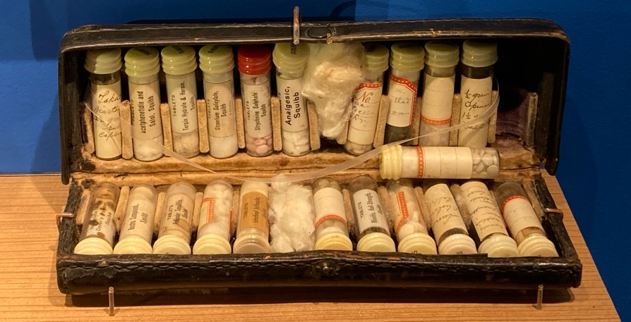
Jack London’s Squibb Medicine Case
On Display in the House of Happy Walls Museum
Notes:
Sole leather medicine case with 22 glass vials, caps with Squibb
All with compressed tablets or capsules
Internal evidence dates it from 1909-1910.
Irving Shepard (1900-1975) son of Eliza London Shepard (1866-1939)
executor, donate > 80 personal items of Jack London's to the
Sate of California in August 1958.
The medicine case was assigned number 241-2-50

Slide 4
The Objectives of This Presentation Are:
(1)To describe the drugs in the medicine case that were used by Jack London to treat his rheumatism, malaria, gastroenteritis (dysentery), bacterial skin infections and his chronic bronchitis.
(2)To show that he understood the germ theory of disease, what drugs to use for his various medical conditions and the potential for their toxicities.
(3) To provide examples of how he used some of these drugs as dramatic elements in his novels and short stories and to examine the claim by some that he was addicted to opium and Heroin.
Notes:
Objectives:
(1) Find drugs that were known to be used by Jack London.
(2) To show that he had a deep understanding of the germ theory,
drug actions, and the potential for drug toxicities.
(3) The provide examples of how he used some of these drugs as
dramatic elements in his novels and short stories.

Slide 5
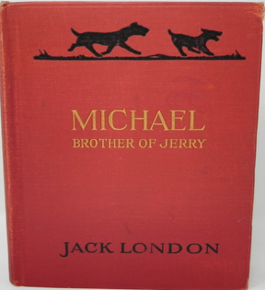
(1) Rheumatism in Jack London’s
Life and Literature
Letter to Edgar G. Sisson (Feb 15, 1915)
“Have been laid up with inflammatory
rheumatism.”
Labor et al. (ed), Letters, V3 p 1427.
Michael Brother of Jerry (1915)
“Rheumatism is still the great mystery,” Doctor
Emory said. . .”It’s almost individual, there are so
many varieties of it. Each man has a kind
of his own.”
Michael Brother of Jerry, C19, p 165, 1917.
Notes:
Jack London's use of drugs to treat his rheumatism is documented in his writings and his letters.
Today over 200 different conditions affect joints, bones, muscles and soft tissues. Arthritis one type of rheumatism.
Dr. Emory's accurate description of rheumatism is from past and current medical literature.
Edgar G. Sisson was editor of Cosmopolitan which serialized Michael Brother of Jerry from May to October 1917.
A background motif in much of his literature:
(a) disease conditions are included
(b) the drugs and their use to treat these conditions.
All dates in parenthesis following the cited publications are the dates the article was written.

Slide 6
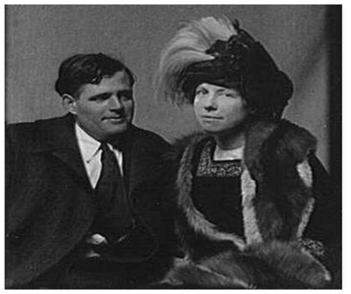
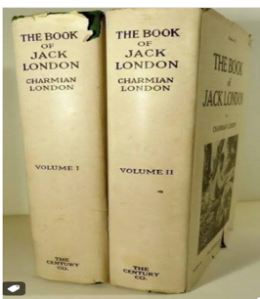
Pain and Inflammation of Rheumatism
At the State Fair in Sacramento, Sep 15, 1916. “after arrival…he was obliged to keep to bed for eight days with a session of rheumatism in his left ankle. . .the doctor had to prescribe powders for the worst nights. ” Charmian K. London, The Book of Jack London, V 2. p 361, 1921.
Notes:
Jack London's battle with rheumatism confirmed by Charmian London in her book on their life together published in 1921.

Slide 7
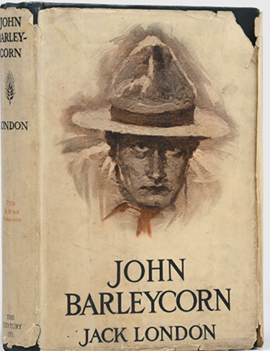
Rheumatism
John Barleycorn (1913)
“And then there was the matter of typewriting. . .How my back used to ache with it! . . .Also, it made me doubt my shoulders. They ached as with rheumatism.”
John Barleycorn C22, pp221-222 (1913)

Slide 8
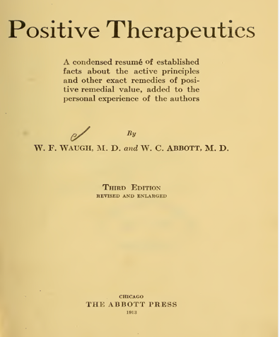
Salicylates for Rheumatism
“Salicylic acid and its salts and derivatives have been used with benefit in rheumatism. . .It is best given to rheumatics in doses of 1 – 6 grain [63-360 mg]. . .This gives better results than bulky doses that may irritate the stomach.”
Waugh, W. F., Abbott, W. C.
Positive Therapeutics
Chicago: The Abbott Press, 3rd ed, p 584, 1913, HL 336122.
Notes:
Positive Therapeutics written by the two MDs William F Waugh and Wallace C. Abbott. Jack London owned medical books them including this one. In this and earlier books their focus was to discourage the use of herbal medicines (inconsistency of dosage amount etc.). Instead, Abbott the founder in Abbott Pharmaceutical pioneered the development of unit dose compressed tablets.

Slide 9


Salicylate:
A Drug to Treat Pain, Inflammation and Fever
Willow trees (Salix alba)
Meadowsweet (Spirea alba)
In Human Body
Salicin Salicylate
Notes:
The bark of the willow tree and the flowers of the meadowsweet plant
contain salicin which the body converts to salicylate.
The ancient Greek and Roman writers Hippocrates, Celsus, Pliny the Elder and Dioscorides all described the
healing power of the bark and flowers to treat pain and
inflammation.
These natural products, dried, ground up and added to water, tea or beer
also reduced fever.

Slide 10
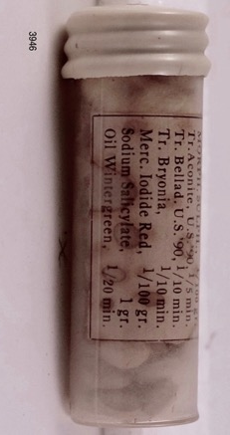
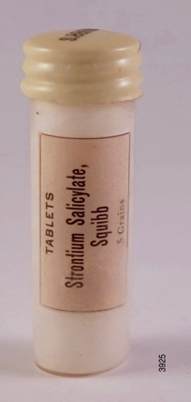
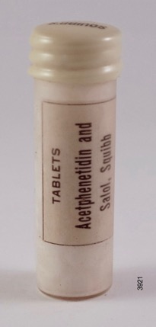
Salicylate Pills in Jack London’s
Medicine Case
Strontium Salicylate Phenyl Salicylate Sodium Salicylate
Methyl salicylate
Notes:
Salicylate by mouth induces major GI upset, indigestion heartburn, nausea etc.
Salicylate is available today only in creams and lotions.
Salicylate derivatives like these were developed to reduce the problems
when taken by mouth.
The need to reduce the pain and inflammation of rheumatism drove the need for oral systemic dosing.
They helped but did not eliminate the toxicity problems.

Slide 11
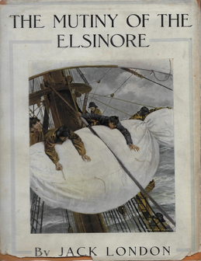
Acetyl Salicylate (Aspirin®)
The Mutiny of the Elsinore (1913)
The narrator described how Margaret West treated the deck hand
Wada, “several days back, when Wada suffered from a
severe headache, she was quite perturbed, and dosed him with
aspirin.”
The Mutiny of the Elsinore,
New York: The Macmillan Company,
C17, p 118, 1914
Notes:
Bayer Pharmaceutical Company invented the safest form of salicylate in 1897, acetyl salicylate.
It made-up the trademark name Aspirin, from "a" from acetyl, the chemical added to make salicylate safer and "spir" from Spirea alba, the meadowsweet plant which produces salicin.
Squibb did not sell Aspirin tablets during the period of the medicine case only the Aspirin powder which drug store pharmacists and other drug companies pressed into pills.
By 1913 Aspirin had entered Jack London’s literature.

Slide 12
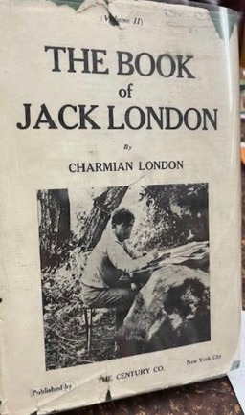
(2) Malaria: Jack and Charmian London
Treat Their Malaria Infections.
On the way home from the South Seas in late 1908,
”I was time and again laid low with the terrible Solomon Island malaria. Jack and Nakata suffering [with] light attacks nursed me.”
Charmian K. London,
The Book of Jack London, New York: The Century Co.,
C31, p 175. 1921.
At home on the ranch in Glen Ellen
“exuberance in our general happy estate was sorely tempered by anemia and sporadic attacks of the vicious malaria that so impaired my usefulness.”
The Book of Jack London, C32, p 180, 1921.
Charmian K. London
Notes:
Jack, Charmian and Nakata (Jack London's valet) all contracted malaria while in the Solomon Islands in 1908.

Slide 13
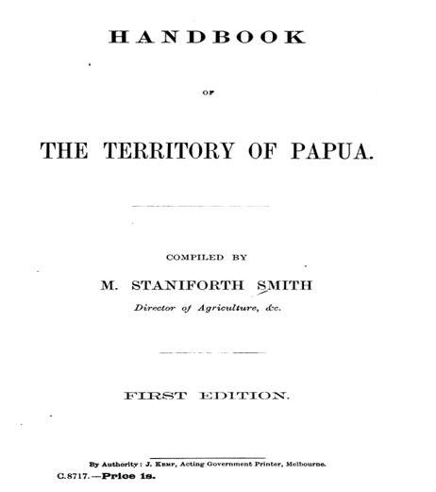
Quinine
“Malarial fever is not uncommon, but, owing to the discoveries made in recent years regarding the cause and treatment of malaria, it is now possible, by using quinine . . to obviate all serious danger from malaria.” pg 9
Smith, M. S. Handbook of the Territory of Papua, 1907, 108 pages. HL 332736.
Notes:
The Handbook was owned by Jack London, HL 332736.
Jack London marked a paragraph describing the treatment of malaria with quinine.

Slide 14
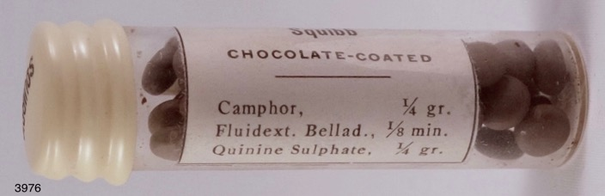
Quinine Tablets in the Medicine Case
Quinine in a vial of Rhinitis Half-Strength tablets
Notes:
The bark of the Peruvian Cinchinoa tree, "the fever tree" contains the antipyretic, quinine.
Spanish conquistadors took the bark back to Europe in 1630, and it was found to cure malaria caused by the Plasmodium parasite.
By the time of the 1909-1910 medicine case, quinine was being added to a wide variety of medications.

Slide 15
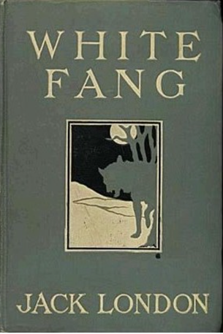
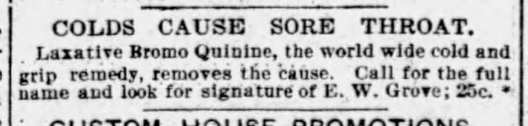
Quinine
White Fang (1905)
Henry says to his partner Bill,
“You’re off color, that’s what’s the matter with you. . . What you need is quinine, an’ I’m goin’ to dose you up stiff as soon as we make Mc Gurry.”
White Fang C2, p 24
SF Examiner 02-12-1905 p 9
White Fang, Macmillan 1906
Notes:
Quinine is good for anything.
The ad below in the slide is for Laxative Bromo Quinine.
McGurry was a fictional trading post and settlement that represented civilization and safety.

Slide 16
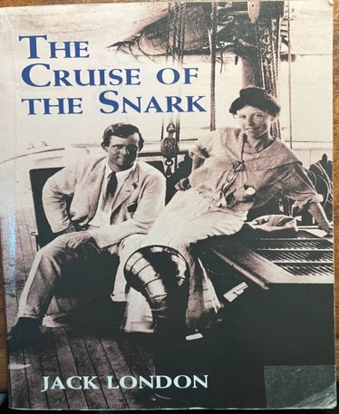
Quinine
Cruise of the Snark (1908).
”Charmian had been raised a vegetarian. . .did not believe in drugs. . . . But listened to the argument in favor of quinine, accepted it as the lesser evil, and in consequence had shorter, less painful, and less frequent attacks of fever.”
The Cruise of the Snark, NY: Macmillan Co., C17, p 329, 1919.
Macmillan 1919 (Dover reprint 2000)

Slide 17
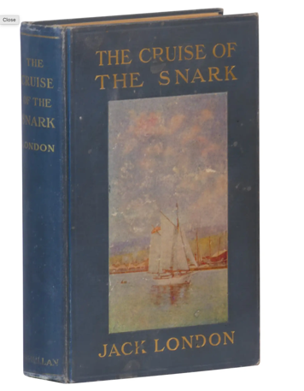
Quinine
The Cruise of the Snark (1908)
“We encountered a Mr. Caufield, a missionary. . .he had been a firm believer in homeopathy, until after his first fever, whereupon. . .he made a grand slide back to allopathy and quinine.”
The Cruise of the Snark
Macmillan, 1911
The Cruise of the Snark C17, 1911, p 329.
Notes:
Jack London took aim in 1908 at homeopathy.
An example of his rejection of a medical treatment that did not follow scientific principals.
In homeopathy the dose of quinine used to treat malaria was zero. The cure was achieved because the water that was used to dilute the quinine level down to zero retained an "imprint" of the quinine on the water molecules.

Slide 18
Jack London: Do Drugs Work?
“How do I know that it was the right stuff? I had no experience. Just because I happened to get well while using it was not proof that it had played any part in the cure. There were such things as coincidence.”
The Cruise of the Snark (1908), New York: Macmillan, Chap 17, p 320, 1919.

Slide 19
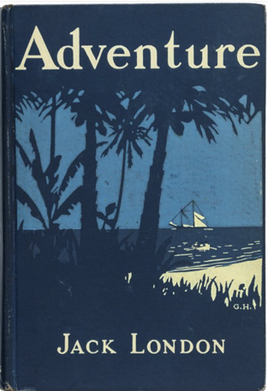
Quinine
Adventure, (1909)
David Sheldon, “ had taken thirty grains of quinine, and the drug was buzzing in his ears like a nest of hornets, making his hands and knees tremble, and causing a sickening palpitation of the stomach. Once, opening his eyes, he saw what he took to be an hallucination.”
Adventure C4 p 32, 1911
Adventure, Macmillan, 1911
Notes:
Jack London accurately described "Cinchonism" due to an overdose of quinine.
Sheldon took 30 grains of quinine = 1950 mg
Three times higher dose that was is safe.
The usual adult therapeutic dose = 640 mg
Katzung 2024, "tinnitus, headache, nausea, diarrhea, flushing and visual disturbances." p 976.

Slide 20
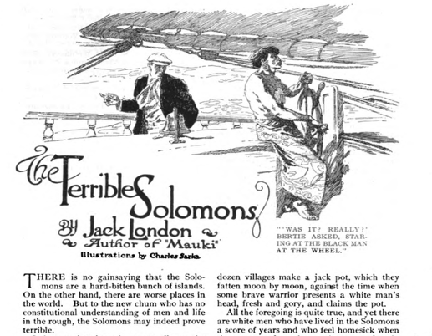
(3) Gastroenteritis (Dysentery and Cholera)
“It is true that fever and dysentery are perpetually on the walk-about [in the Solomon Islands]. . .One item that occurred with monotonous frequency was death by dysentery.”
“The Terrible Solomons,” (1908) in
Tales of Cannibals and Headhunters,
Riedl, G., Tietze, T. R.,(ed) U New Mexico Press, pp 135-160, 2006
Hampton’s Magazine 24:347-354 (March 1910)
Notes:
Illustrated magazine publication vs final book publication.
Death was due to sudden massive fluid loss and dehydration.
Dysentery-due to bacteria or single celled parasites.
Bacillary dysentery. . .Shigella bacteria
Amoebic dysentery. .Entamoeba
Both cause bloody diarrhea
Cholera-due to Vibrio cholerae bacteria,
massive loss of water with diarrhea, no blood.
Both require antibiotics, fluid replacement,
Both caused by fecal contaminated water and/or food.
2000+ today in US have dysentery from Cyclospora, a single celled parasite found on fecal contaminated lettuce served at Taco Bells.
Treat with Bactrim (trimethoprim-sulfamethoxazole) not invented until 1938. In 1914, use opium.

Slide 21
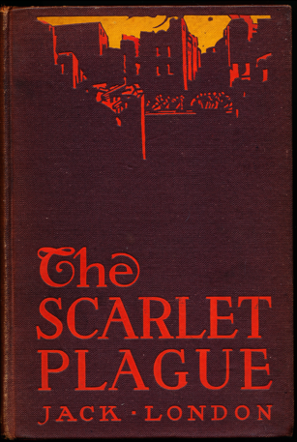
Cholera
The Scarlet Plague, (1912)
“There was the old Asiatic Cholera, when you might eat dinner with a well man in the evening, and the next morning. . .you would see him being hauled away by your window in the death-cart.”
Macmillan C3, p 73, 1915
Macmillan 1915
Notes:
Asiatic cholera was the cholera due to the bacterium Vibrio cholera.
The severe dehydration caused by massive diarrhea often caused death within hours or days in children and some adults.
This dystopian novella was inspired by Poe's The Masque of the Red Death published in 1842.

Slide 22
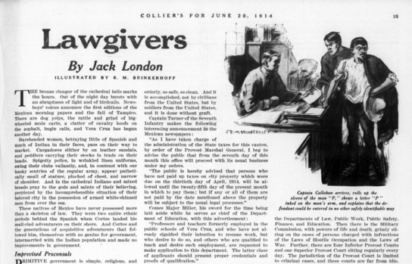
Gastroenteritis(Bacillary Dysentery)
Jack London letter to E. C. Browning, 1914
”I am just back from [Vera Cruz] Mexico, recovering from a severe attack of rotten, bacillary, tropical dysentery.”
Labor et al. (Eds), Letters, June 22, 1914, Vol 3, p 1334
Collier’s Magazine, 53(14):15-16, 28-29 ( June 20, 1914)
Notes:
Jack London was on assignment for Collier's Magazine to report on the Mexican-American war in 1914. He wrote six articles for Collier's.
Bacillary dysentery was diarrhea caused often by Shigella bacteria found in fecal contaminated water and food products.
Treatment includes fluid replacement and use of antibiotics cirprofloxacin (FDA approved 1987) or azithromycin (FDA approved in 1991).
In 1914 use opium.

Slide 23
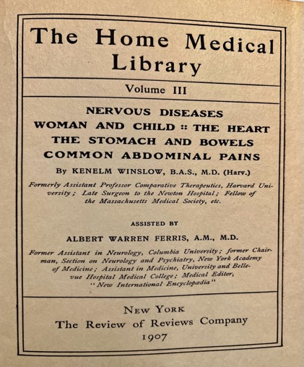
Gastroenteritis (Treatment)
“opium in some form is the essential remedy.” p 227
“Squibb’s cholera. . .may be employed.” p 231
Winslow, K, The Home Medical Library, NY: The Review of Reviews Company, Vol III, C2,1907. HL 338746
Notes:
All opioids reduce pain, stop diarrhea etc.
The Home Medical Library was a six-volume set of medical books written and edited by Kenelm Winslow, MD.

Slide 24
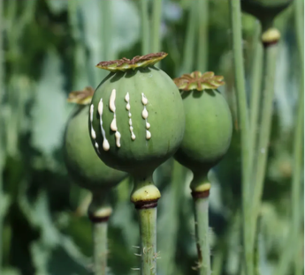
Opium
Opium (from Papaver somniferum)
morphine (1805) methyl morphine (1832)
(codeine)
Notes:
The latex collected from the poppyseed capsule is dried and pressed into a brick. A piece broken off and chewed, smoked in a pipe, dropped into ethanol or a beer are all simply ways of getting morphine and methyl morphine (codeine) into the body.
The above dates are the dates morphine and codeine were isolated from the poppy plant latex.

Slide 25
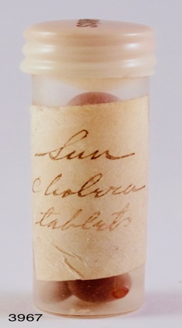
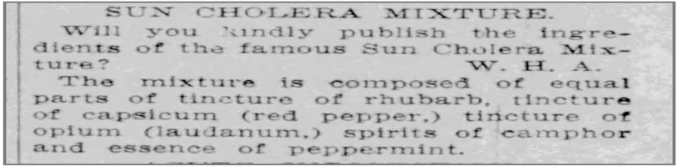
Did Jack London Abuse Opium?
Charmian K. London (1871-1955) from her diary, July 31, 1908.
“Mate in bad shape-keeping bowels in check with cholera pills (opiate) [sic].”
San Francisco Chronicle, July 29, 1906, p 6
Squibb Medicine Case
Notes:
Sun Cholera tablets were equal parts of opium, capsicum, camphor, and peppermint.
In NY City in 1849 there were 5071 deaths from cholera, due to a bacterial infection from the bacterium Vibrio cholerae.
In 1849 G. W. Busteed a pharmacist in NY City published in the NY Sun newspaper a formula for Sun Cholera Tablets. The paper republished the formula over 1000 times between 1849 and 1898.
The formula in the SF Chronicle in 1906.

Slide 26
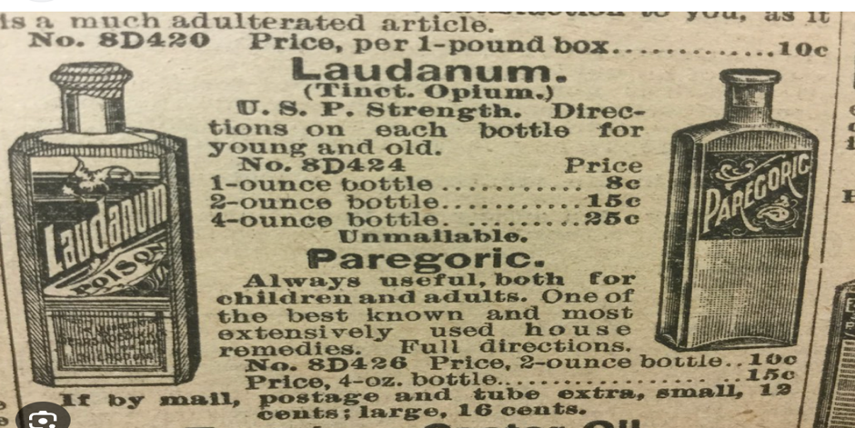
Opium
The1902 Sears Roebuck Catalog, No.112, p450
Notes:
In most of Jack London's lifetime opium, morphine and codeine were legal, did not require a prescription and were available over the counter.
Laudanum was the dried opium powder (latex) dissolved in ethanol.
Paregoric was "less" opium dissolved in ethanol and safer for children.
Opium use in the first few years of the 20th century was considered like taking aspirin today (Jack London died in 1916).

Slide 27
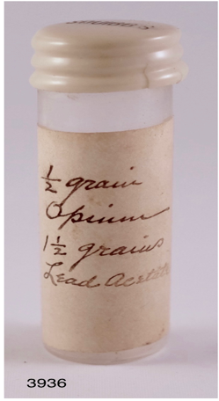
Opium & Lead Acetate
Opium & Lead Acetate
opium 32 mg
lead acetate 96 mg
“Opium and lead acetate for reducing pain.”
Included in Jack London’s typed list of drugs
for his Boat Medicine Chest, (1906?)
Huntington Library, JL 21308 Box 36.
Notes:
Lead acetate also called sugar of lead because it is sweat tasting.
Used in Roman times to sweeten wine and some foods.
Lead acetate like opium is a potent astringent which helps stop diarrhea.

Slide 28
The Harrison Narcotics Act 1914
On July 22, 1914, Charmain London in a letter to Dr. W. S. Porter asked for prescriptions for 50 capsules, each with the following:
(a) Opium 1 gr
(b) Opium 1/2 gr + Bismuth subgallate 13 gr
(c) Bismuth subgallate 30 gr
(d) Bismuth subnitrate 30 gr
Huntington Library, Jack London documents 10435, Box 258.
Notes:
Dr. William S. Porter was Jack London's personal physician from 1913. He was also a life-long friend of Jack and Charmian's.
The Harrison Narcotics Acts was signed by Congress in 1914.It required a prescription for all opioid products. The act did not become enforced until March 1, 1915.
By by March 1, 1915, in the US, opium, morphine, codeine now required a written prescription and all physicians had to be registered and keep records on how much dispensed and to whom.

Slide 29
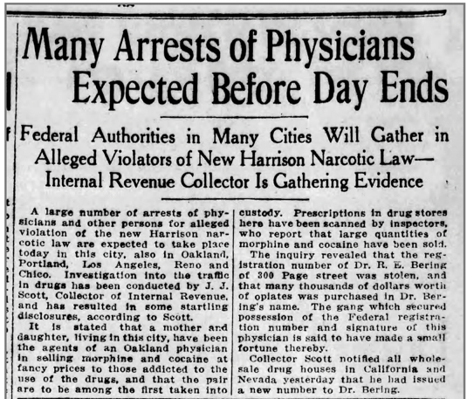
Bowman Pharmacy Letter to Jack London
Bowman, “All that will be necessary in order that you may have your medicine chest filled . . .is to get your doctor to write the. . . prescription. We are also enclosing a copy of the Harrison Act.”
Bowman Pharmacy Letter to Jack London,
Oct 18, 1915, HL Jack London 2826, Box 134
San Francisco Chronicle, Friday, Nov 12, 1915, p 2
Notes:
A letter from Bowman Pharmacy in Oakland on Oct 18, 1915 informing Jack London that the prescription for 12 opium capsules were filled.
He now needed, they told him, that he required a prescription for the 38 more tablets he asked for.
The SF Chronicle article from Nov 12, 1915, warns pharmacists to not dispense opioids without a written prescription.
Bowman Pharmacy was used for years by Jack London and his family. The pharmacy was on Broadway, a short trolley car ride from Jack London's Oakland home on 27th St.

Slide 30
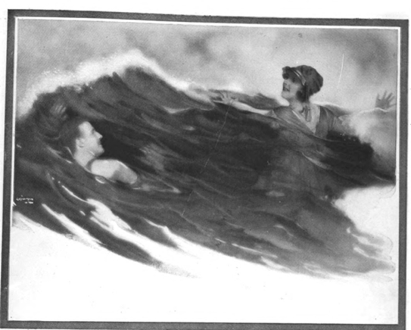
Opium in “The Kanaka Surf”
Man of Mine (also published as The Kanaka Surf), (written June 1916).
Lee Barton “ tossed under his reading-lamp unable to sleep or read. At the end of an hour he was out of bed and into his medicine-case. Five grains of opium he took straight. An hour later, afraid of his thoughts and the prospect of a sleepless night, he took another grain. At one-hour intervals he twice repeated the grain dosage.”
Hearst’s magazine, Feb 1917, p 111
Notes:
The central motif of this short story is that the actions of Lee Barton were caused by his ingestion of opium.
He ingested in one night 520 mg opium, 10% is morphine which is 52 mg ingested, today 30 mg is a typical maximum oral dose of morphine.
He faked drowning with his wife when they were both in the deep Kanaka surf. He wanted to deal with the perceived infidelity of his wife.
He developed a severe cramp and the two of them almost drowned. She saved his life.
The use of opium ingestion to justify the characters actions were used by many others
Wilkie Collins The Moonstone (1868)
Charles Dickens The Mystery of Edwin Drood (1870)

Slide 31
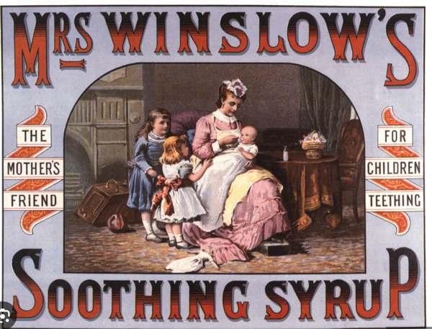
Jack London and the Patent Medicine Era.
~1905 ad for morphine dissolved in a small amount of ethanol.
Notes:
The syrup used for teething babies was a mixture of ethanol and morphine sold over the counter from 1865 to 1906.
The years 1865 to 1906 are considered to be the Patent Medicine era in American medical history.
These drugs were not patented, instead it was the bottle or box that had a design patent.
The deception occurred because there was no requirement to disclose the contents of any medicine, any bottle of juice or can or box of food
A can of "tuna fish" might contain 10% tuna and 90% shark meat, all beef hot dogs might be 75% horse meat etc.

Slide 32
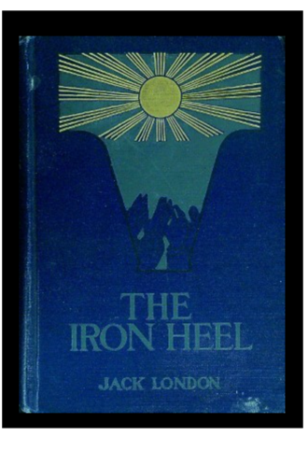
Patent Medicines
The Iron Heel (1906)
”This editor, who published patent medicine advertisements, called me a scoundrelly demagogue because I dared him to print in his paper the truth about patent medicines.^{2 [sic]}”
“2. Patent medicines [sic] were patent lies, but, like the charms and indulgences of the Middle Ages, they deceived the people. The only difference lay in that the patent medicines were more harmful and more costly.”
The Iron Heel C5 The Philomaths, p 81, 1908
The Iron Heel, Macmillan
February 1908
Notes:
Jack London fought against patent medicines, In his novel, The Iron Heel written between August and December 1906 he wrote about Patent Medicines.
In June1906 the FDA legislation was signed into law. The only regulation that they were required to enforce was Truth in Labeling.
Soon, Mrs. Winslow's Soothing Syrup must now be labeled
"Mrs. Winslow's Soothing Syrup contains morphine and ethanol."
Will mothers buy that?

Slide 33
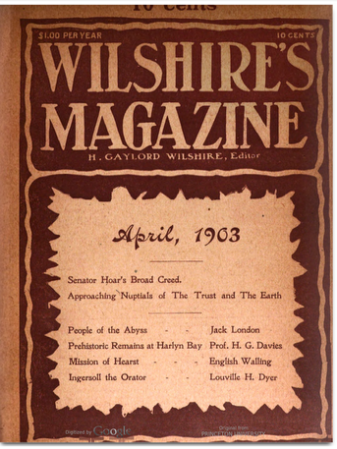
(4) Fighting Infections Before Antibiotics
“True, the sanitation of the places I visited was wretched. . .I might expect my wife and babies speedily to be attacked by diphtheria, croup, typhoid, erysipelas, blood poisoning, bronchitis, pneumonia, consumption, and various kindred disorders.”
The People of the Abyss (1902)
Wilshire’s Magazine No 57, April 1903, Chap III My Lodging and Some Others, p 19.
Notes:
The People of the Abyss non-fiction reporting on life in the East end of London was first serialized in the progressive, socialist magazine Willshire's.
diphtheria Corynebacterium
croup cough, parainfluenza virus
typhoid Salmonella typhi
erysipelas Strep infection of the skin
blood poisoning Bacterial sepsis
bronchitis viral, cold and flu or physical (smoke etc.)
pneumonia bacterial, virus or fungal
consumption pulmonary TB

Slide 34
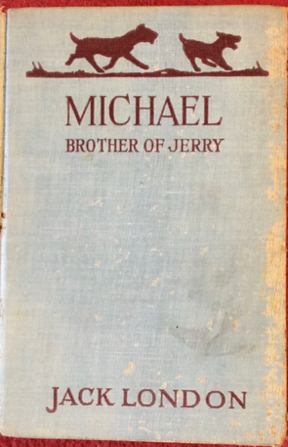
Jack London Knew the Germ Theory Developed by
Louis Pasteur (1822-1895) and Robert Koch (1843-1910)
Michael Brother of Jerry (1915)
“The doctors took over forty stiches in him and shot him with that Pasteur dope for hydrophobia.”
Macmillan, C28 p 255, (1917)
“The Rejuvenation of Major Rathbone” (1897)
“Koch’s experiments with lymph darted across my mind.”
Walker, D.L. (ed), Curious Fragments, 1975, pp 27-36
Quote on p 28.
New York: Grosset & Dunlap, 1917 edition
Notes:
Pasteur and Koch are considered the major founders of the Germ Theory of disease developed by them in the late 19th Century and debated, tested and argued over in the first few decades of the 20th century.

Slide 35
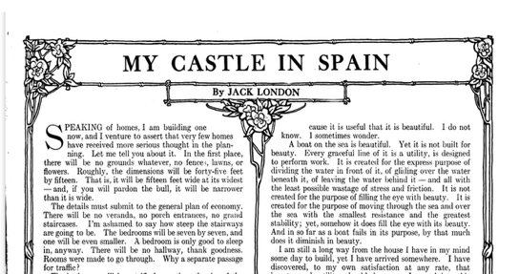
The Germ Theory:
Invisible Bacteria Cause Disease
“My Castle in Spain" (1906)
“There will be hard-wood floors in my house. . .Beautiful carpets are not beautiful to the mind that knows they are filled with germs and bacilli. They are no more beautiful than the hectic flush of fever or the silvery skin of leprosy.”
House Beautiful p 17 Jan 1907
House Beautiful 21(2):15-17 (January 1907)
Notes:
How could something that you could not see cause a human to fall sick and possibly die?
Malaria comes from the Italian "mal aria" or bad air.

Slide 36
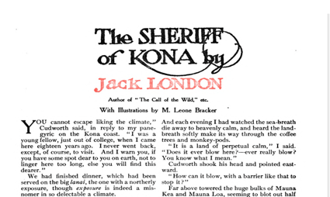
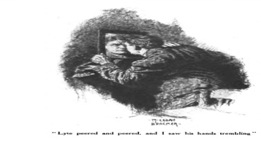
Germ Theory:
Specific Bacteria Cause A Specific Infection
“The Sheriff of Kona” (1908)
“He was a leper. No, he was not born with it-no one is born with it; it came upon him. . .You undergo a bacteriological examination. . . Snip out a piece of skin and make the test.”
American Magazine 68:384-391 (Aug 1909)
The Cruise of the Snark (1908)
“They have isolated the bacillus of leprosy. . .bacillus leprae.”
The Cruise of the Snark
C7 The Lepers of Molokai, pp109-110, 1911
American Magazine 68:384-391 (Aug 1909)
Notes:
The organism that caused leprosy was included in many of his writings.
Chapter 7 in The Cruise of the Snarl is all about leprosy (Hansen's Disease)
The organism that causes leprosy was discovered in 1873, Mycobacterium leprae Hansen.

Slide 37
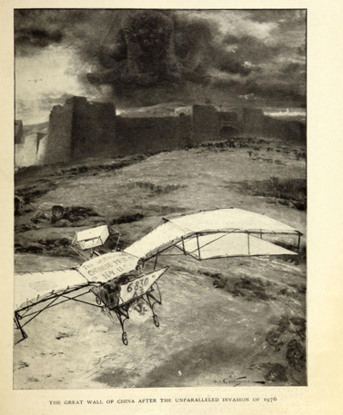
Germ Theory:
Darwinian Natural Selection Governs Bacteria
”The Unparalleled Invasion” (1907)
“a new plague-germ had originated, that in some way or other a sort of hybridization between plague-germs had taken place, producing a new and frightfully virulent germ. . . Such was the unparalleled invasion of China.” p97
“The Unparalleled Invasion” in
The Strength of the Strong, Macmillan, 1914, pp 71-100.
McClure’s 35(3):308-315 (July1910)
Notes:
The principal of Darwinian Natural Section described as an element in The Unparalleled Invasion in 1907.
This story was an early description of germ warfare delivered from planes.

Slide 38
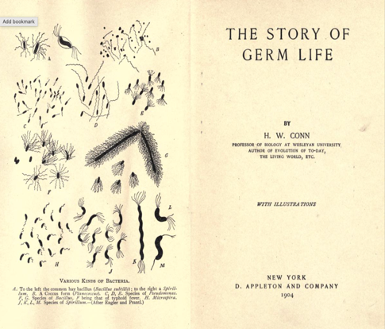
Drugs To Combat Bacterial Infections
“Corrosive sublimate [mercuric chloride] is a substance which destroys all pathogenic germs with great rapidity. . .and cannot be used as a drug in sufficient quantity to destroy the parasitic bacteria in the body [when taken internally] without at the same time producing poisoning effects on the body itself.”
Conn, H. W. Chap VI, Methods of Combating Parasitic Bacteria, p 185, 1904. HL 337069
Conn, H. W. The Story of Germ Life, 1904
Notes:
Jack London owned the Conn book which was a basic microbiology text that covered the Germ Theory of disease.
Combating disease organisms was limited in 1904 to mercury-based drugs.

Slide 39
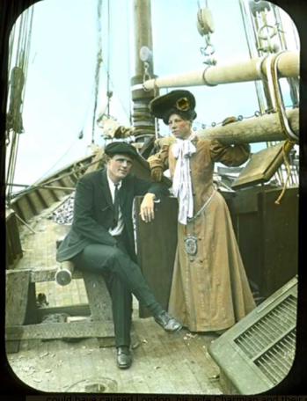
Drugs to Combat Bacterial Infections
“at Apia [Samoa] my ankles were badly bitten by mosquitoes. . .a small sore had developed. . .I read through all the medical books onboard. . Here were malignant and excessively active ulcers that were eating me up. . .I decided to fight the poison with corrosive sublimate [mercuric chloride].”
The Cruise of the Snark, Chap 17, p 314-315, 1919.
Jack and Charmian London
Notes:
Jack London described his skin infection called yaws caused by the bacterium Treponema pallidum pertenue.
Today cured by a single oral dose of azithromycin, FDA approved in 1991.
Corrosive sublimate (mercuric chloride) was one of many mercury-based chemicals which when dissolved in water could be used as a topical wash to treat a skin infection.

Slide 40
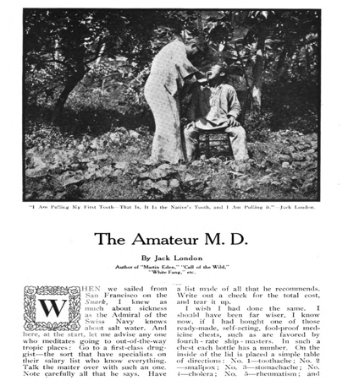
Mercury Chemicals to Treat Infections
“Go to a first-class druggist-the sort that have specialists on their salary list who know everything. . .Note carefully all that he says. Have a list made of all that he recommends. Write out a check for the total cost and tear it up. . So far, with the exception of corrosive sublimate [mercuric chloride](which has been recommended as an antiseptic in surgical operations. . .) my medicine-chest has been useless.”
The Cruise of the Snark, C17, p 308,1911
The Pacific Monthly, 24(2): 187-203
(August 1910)
Notes:
Jack London summarizes his frustration with the early 20th century medicine cases and the toxic drugs offered to fight bacterial infections.
He died in 1916, twenty-four years before the world's first antimicrobial, sulfonamide.

Slide 41
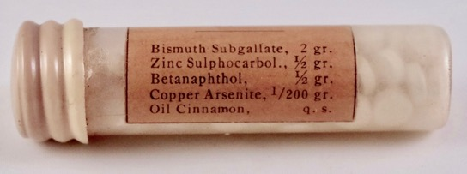
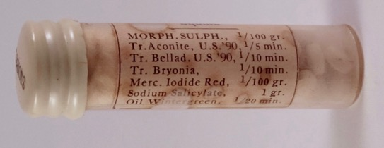
Antimicrobial Drugs in the Medicine Case
Squibb Intestinal Antiseptic Copper Arsenite
Cupric arsenic
Treat catarrh (postnasal drip)
1-2 tablets ever 3 hours until relieved
wood preservative
herbicide
pesticide
fungicide
Squibb Follicular Tonsillitis. Mercuric Iodide Red
Mercuric Iodide, red
Treat conditions like Strep throat
One tablet on the back of the tongue every hour
topical antiseptic (toxic if absorbed through the skin)
Fatal if swallowed
Notes:
Both antimicrobial drugs in the Squibb medicine case were mercury-based drugs intended for oral consumption.
The internal damage caused by mercury compounds was well known by 1903.
Copper arsenic used as wood preservative, insecticide, fungicide and rodenticide.

Slide 42
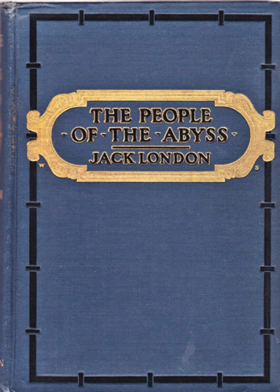
(5) Chronic Bronchitis
And Jack London’s Use of Terpin Hydrate & Heroin
The People of the Abyss (1902)
“Then there are the ‘dangerous trades,’ in which countless workers are employed. . .In the linen trade, in the preparation of flax, wet feet and wet clothes cause an unusual amount of bronchitis, pneumonia and severe rheumatism.”
The People of the Abyss, C21, p 257 (1903)
Notes:
Bronchitis described by Jack London in 1902.
Acute bronchitis: caused by a virus, like the flu etc.
Chronic bronchitis: is the inflammation caused by the constant exposure to environmental pollutants (particles, chemicals, tobacco smoke etc.)
Both result in the build up of mucus plugs in the bronchial airways and the constant coughing to remove this obstruction.

Slide 43
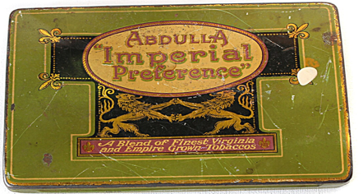
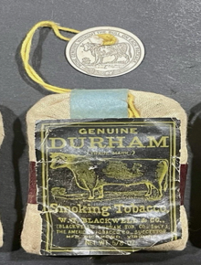
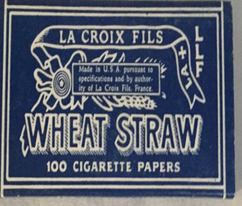
Chronic Bronchitis From Smoking
“Ship to Batavia, five thousand (5000) Imperial cigarettes. . . sealed in a tin. . .ten (10) pounds of Bull Durham. . .also 100 packages of Wheat-Straw Papers.”
Labor et al., Letters, Feb 27, 1908, Vol 2, p 741.
Letter to Aunt Netta (Ninetta Wiley Eames Payne,
sister of Charmian’s mother.
He was unable to speak from March 10 through the 30th 1910 due to his bronchitis.
Kingman, R. A Definitive Chronology, p 127 (1992)
Notes:
Jack London's smoking may have led to his chronic bronchitis.

Slide 44
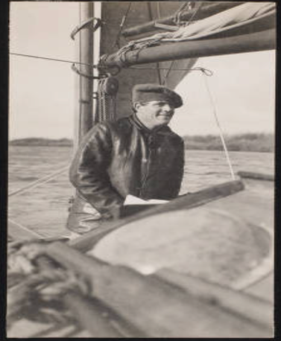
Bronchitis
Charmain K. London (July 07, 1910)
“he told me he was having his sputum examined for traces of tuberculosis, for he was thoroughly alarmed at the obstinacy of the racking cough and soreness in his chest. . . The analysis of the sputum brought to light no evidence of active ‘T.B.’”
C. K. London, The Book of Jack London, Vol 2, p 193, (1921).
On his sailboat the Roamer, 1910
Huntington Library JLP-Alb-086-043
Notes:
Jack London had himself tested for TB because of the obstinacy of his cough and soreness in his chest. The sputum test was negative.
June 10, 1910 . . CKL Book of Jack London 1921, Vol 2, p 193.

Slide 45
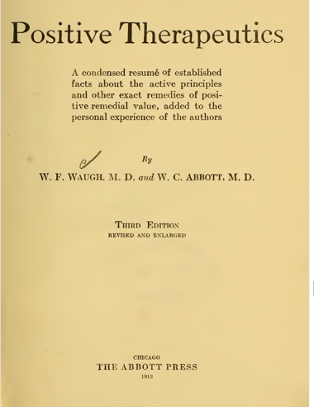
Bronchitis
“But it is in affections of the respiratory apparatus that codeine finds its chief use. It sooths the disposition to cough and promotes freer expectoration. . .In dry coughs he [Van Renterghem] gives codeine . . .Trousseau also recommended codeine in acute bronchitis. . .and [for] constant cough”
Waugh, W. F. and W. C. Abbott,
Positive Therapeutics, Chicago, The Abbott Press, p 300, 1913. HL 336122
Notes:
All opioids available at the time (opium, morphine, codeine and Heroin) helped suppress the overactive cough reflex which occurs because of the irritation of the bronchial airways. This level of cough reflex was an unproductive cough.

Slide 46
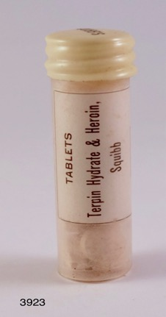
Opium
Opium (from Papaver somniferum)
morphine (1805) methyl morphine (1832)
(codeine)
diacetyl morphine (1898)
(Heroin®)
Notes:
Heroin was released by Bayer Pharmaceutical in 1898.
The addition of two acetyl groups to morphine created a new opioid that entered the brain faster than morphine. Created the "rush" that addicts wanted.
The new drug was diacetylmorphine which Bayer trademarked as Heroin because when they tried the drug it made them feel heroic, in German heroisch (HEH RO ISH )
Bayer sold the drug for oral consumption as either a tablet or a liquid suspension.

Slide 47

Terpin Hydrate & Heroin
Terpin Hydrate
The expectorant which clears bronchial airways of mucus plugs.
Heroin (diacetyl morphine)
An opioid at low doses that blocks persistent non-productive coughing.
Squibb Terpin Hydrate & Heroin
Terpin Hydrate 2.5 grain (162 mg)
Heroin 1/50 grain (1.3 mg)
Notes:
Terpin hydrate introduced in 1855, and often combined with codeine (Terpin Hydrate-Codeine. Terpin Hydrate was replaced in the early 1990s by the FDA with guaifenesin. In 1990 the FDA required that all OTC have clinical trial data that proved that the drug worked (was efficacious). Terpin hydrate worked fine since 1855 and had no recent clinical trial data. Guaifenesin a modern drug ran clinical trials and had the required data.
Heroin (diacetyl morphine) was produced by Bayer in 1896. Promoted by Bayer as the less expensive and non-addictive cough suppressant. Terpin Hydrate & Heroin became the standard of care until 1925 when Heroin was made illegal for any reason. The world went back to Terpin Hydrate & Codeine until the early 1990a.

Slide 48


Two Heroin Ads
Ads from the early 1900s
Notes:
Two ads for Heroin intended to treat chronic coughing.
Bayer and others promoted Heroin as safe and non-addictive. The lower cost and the non-addictive claim caused all companies to change from Terpin Hydrate & Codeine to Terpin Hydrate & Heroin.
The Squibb Terpin Hydrate & Heroin tablet was for oral consumption only with a dose of 1.2 mg Heroin per tablet. Typical doses of Heroin for oral consumption are at 30-50 mg.
Squibb's Heroin tablets intended for SC injection came in 5 and 10 mg dose sizes.

Slide 49

Was Jack London a Heroin Abuser?
“There are a sextant, telescope. . and a tattered case containing vials of drugs, including an ominous concoction labeled ‘Terpin Hydrate and Heroin.’”
(The Press Democrat July 11, 1977, p 10).
Notes:
The Press Democrat in Santa Rosa CA.

Slide 50

Heroin in Jack London’s Medicine Case
Andrew Sinclair (1935-2019)
“The medicine case still on display. . contains heroin, morphine, and opium. . .in other words, he was taking the fatal ‘uppers and downers’ of modern pill pushers.”
(Jack. A Biography. NY: Harper & Row 1977, p 218)
Notes:
Andrw Sinclair's biography of Jack London.

Slide 51

Heroin in Jack London’s Medicine Case
E. L. Doctorow (1931-2015)
“his death at forty, [was] of uremia, or stroke, or accidental overdose of his painkiller of preference, heroin” (p 3, 1990).
Jack London, Hemingway and the Constitution; Selected Essays 1977-1992, New York: Random House, 1993.
Notes:
E. L. Doctorow the American historical fiction writer.
Noted for the high-level research and accuracy in the fact presented in his 12 novels.
Ragtime (1975) adapted into a play that won 4 Tony Awards
Billy Bathgate (1989)
The March (2005)

Slide 52


Heroin in Jack London’s Medicine Case
Meir Kryger, MD (1947- )
“The medical kit from the Snark, shows a vial labeled ‘heroin’ (Figure 2) [sic].”
Kryger, M., “Jack London’s Sleep”, J Clin Sleep Medicine
12(11):1545-1547 (2016).
Notes:
Even a physician got in on the canard about heroin use by Jack London.
Dr. Kryger Professor Emeritus Pulmonary Medicine, Yale School of Medicine.

Slide 53
The Vial of Terpin Hydrate & Heroin in the Medicine Case
Notes:
The vial with Heroin in it, top row, third from the left.

Slide 54


Today’s Terpin Hydrate & Heroin=
Guaifenesin & Codeine
Robitussin AC
Replaced in 20023 with many generic products.
Cheratussin AC (American Codeine) formula
Notes:
Terpin Hydrate, an expectorant, loosen up mucus plugs in bronchial airways. Drug derived from oil of turpentine
Replaced by guaifenesin in the early 1990s'
Heroin introduced as a cough suppressant in 1890.
Replaced with codeine in 1925
Many generic brands of guaifenesin and codeine today.

Slide 55
Was Jack London a Heroin Abuser?
To prove the ingestion of Heroin by an individual, the following must be found in the body fluids and/or tissues: Heroin, 6-AM and 3-AM, the two main metabolites along with morphine.
(1) Taylor thermometer paper certificate March 1906
(2) Chlorodyne glass vial July 1908 (opium, cannabis in chloroform)
(3) Am J Med paper article blood stain Sept 1911
(4) Formamint tablet glass bottle 1914 (lactose &
formaldehyde mouth antiseptic)
(5) Wyeth glass vial opium tablets Nov 22, 1915
Zilberstein, G., Zilberstein, S., Rocco, R. M., Righetti, P. G.
Comptes Rendus Chimie (Chemistry Reports of the French Academy of Science)
25:115-123 (2022)
Notes:
Only five of the nine articles tested contained the required Heroin, morphine and two major metabolites which help demonstrate the use of Heroin. All five objects also contained Terpin Hydrate. which indicates that this was the source of the Heroin. at least on the five objects tested.
(1) Heroin and metabolites found only with Terpin Hydrate
(2) The Squibb tablets were for oral use only, subcutaneous injection not possible.
(3) The Heroin concentration was 1.3 mg/tablet. The usual oral dose of Heroin for normal physiological response is 30-50 mg by mouth.
(4) Two other medicine cases owned by Jack London also contained vials of Terpin Hydrate & Heroin.
(5) None of the three medicine cases contained either Heroin oral tablets at 30-50 mg or Heroin liquid for injection at 10 mg/mL.

Slide 56
Acknowledgement and Thanks.
Denise Rocco-Zilber, for the photographs.
Aleta George, Jay Williams and Ken Brandt for recommending that I do this presentation.
Ciara Pegg, Community Programs and Visitor Partners, Jack London State Park for accepting the proposal and organizing this presentation.

Slide 57
Acknowledgement and Thanks.
Special thanks to the library staff at Samuel Merritt University that helped with obtaining documents: Juana Moreno, Anne Middlebrooks and Gabriela Sam.
Sarah Francis, Assistant Curator, Literary Collections, at The Huntington Library for assistance with the Jack London archives.
Carol Dodge, Museum Curator II (Retired), CA State Parks and Noah M. Stewart, Historian III/Cultural Resources Program Manager, CA State Parks, Bay Area District.

Slide 58

Acknowledgement and Thanks
Thanks also to Susan Nuernberg for technical support and help with the quotations from the diary of Charmian K. London.
                Susan Nuernberg
                The Diaries of Charmian
            Kittredge London 1904-1916
                University of Nebraska Press
                Due out Nov 1, 2027.

Slide 59
Acknowledgement and Thanks
To My Family For Their Support:
Denise, Michael, Zoe, Eli
John, Hayley, Alaya
and Susan
To all who support the Park and this Museum dedicated to the
life of Jack and Charmian London.
©️ Richard M. Rocco, PhD July 29, 2026

